Slide 1

STTC Sensor Dashboard
And Virtual Tour
Interface
Gamal Mustapha, P.Eng, PMP
May 30th, 2018
gamal@smtresearch.ca

Slide 2
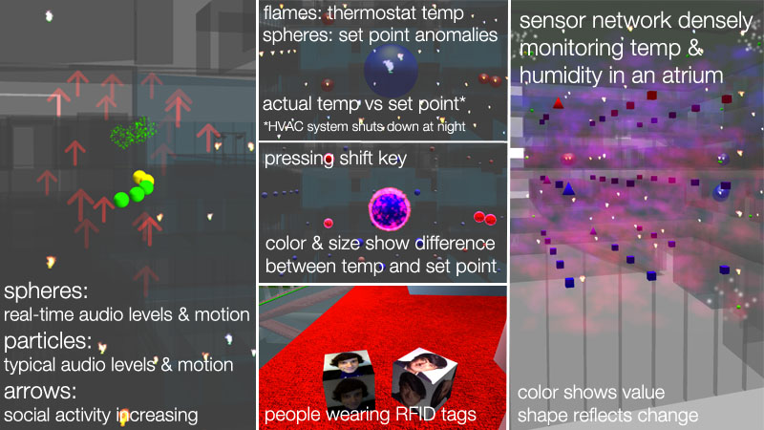
MIT Doppellab
MIT uses Unity VR engine to explore their living lab. http://doppellab.media.mit.edu/
Notes:
1. Interface used for research - Building Analytics engine. Current state-of-the-art.
2. How MIT uses their Unity VR engine to explore their living lab. http://doppellab.media.mit.edu/
3. Tour of the proposed UI. I have incorporated the suggestions given during the meeting so we can review those as well.
4. Discussion and other topics

Slide 3
STTC Project Objectives
Largest embedded IoT sensor network
Extreme weather conditions contribute to a state-of-the-art living lab
Facilitate and foster innovation in
  Building science
  Big data analysis/predictive analysis
  Data visualization/BIM integration
  Automation/robotics
  Energy efficiency/Sustainability

Slide 4
Current Projects/Papers
STTC Sensor network and visualization tools presentation at SHMII-8 in Brisbane, Australia (RRC)
Dynamic Thermal Performance paper and presentation at UVIC New Horizons in Civil Engineering Conference. (SMT/BETAC)
Augmented Reality data visualization – Human Computing Interface Lab (UofM)
BIM Applied Research – Web based 3D data visualization tool (ACE Project)

Slide 5
Current Tools
Sensor data is stored on the cloud and is accessible by 3rd party software tools
SMT web based tool available to analyze data
Data will also be sent to the RRC BACnet system

Slide 6
Interface Objectives
Engaging interface to deliver spatio-temporal data by immersing the user in the building with the ability to see the sensors and view them similar to the MIT DoppelLab
Tool to attract students to explore the IoT world and foster innovation and creativity to expand the system.

